Slide 1
2013_10_14:
Make electroporation-only pCM66T.
Call it pCM66TE

Slide 2
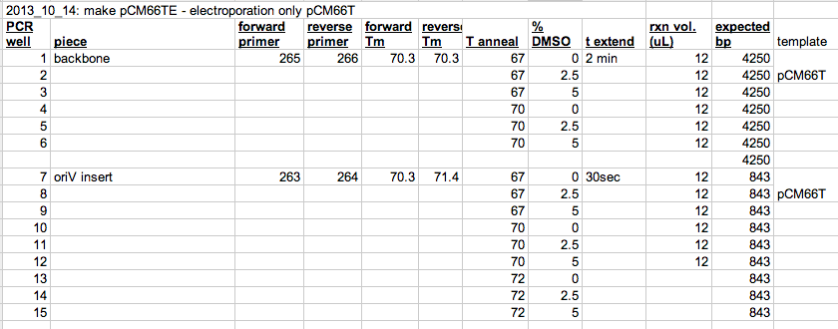
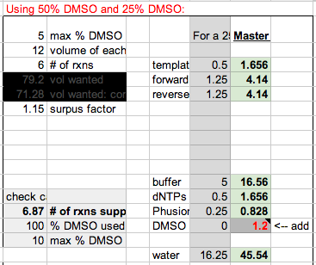
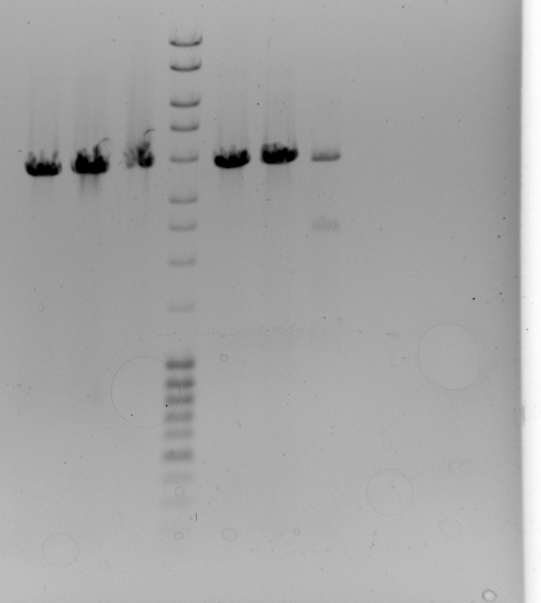
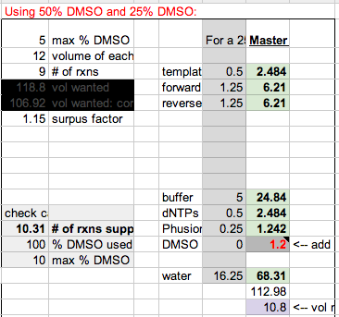
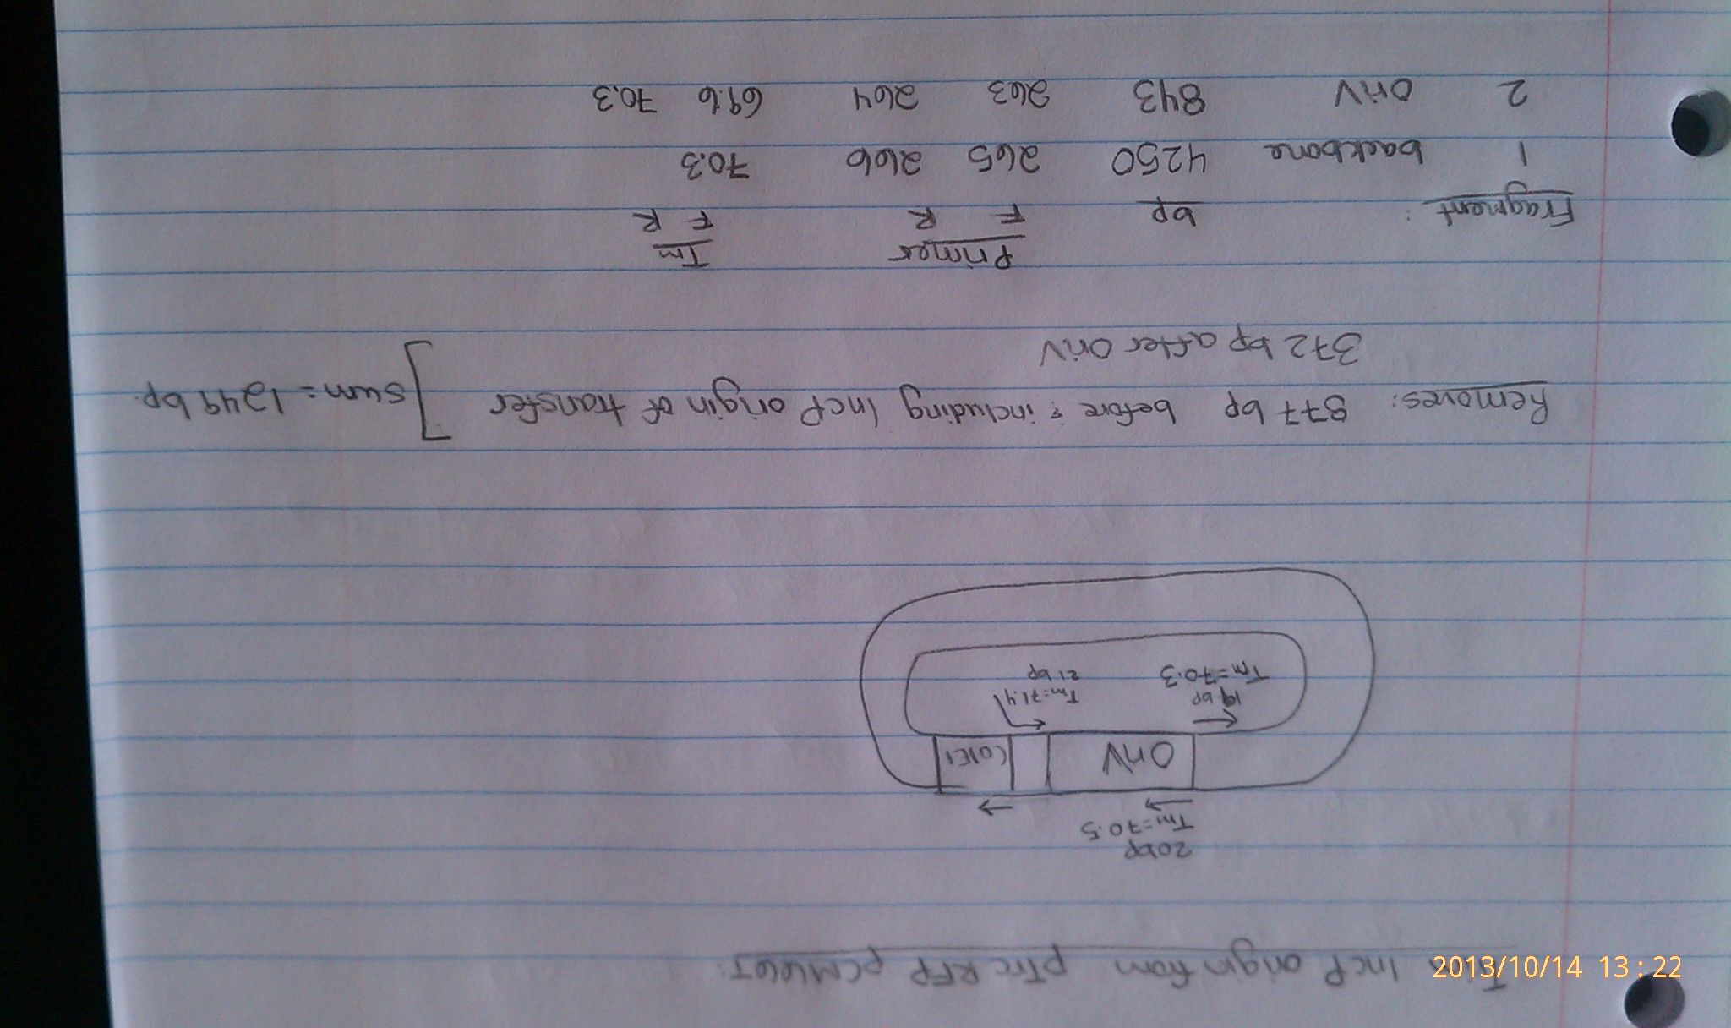
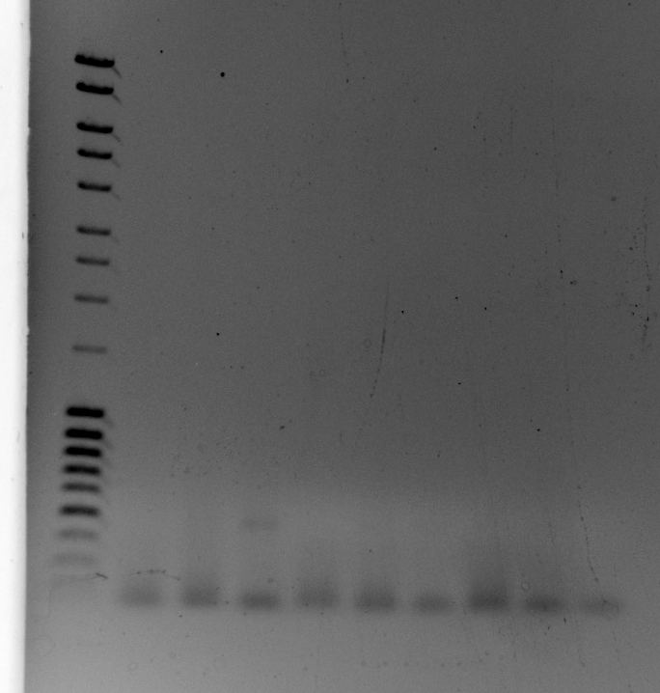
Wells 1-6 are good. Make more of well 4.
Wells 7-15 didn’t amplify. Was primer 264 too high? Order a lower Tm version.

Slide 3
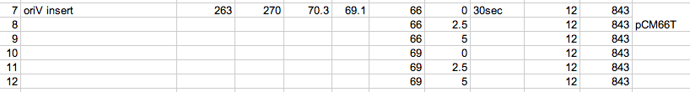
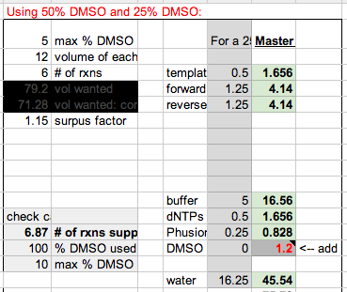
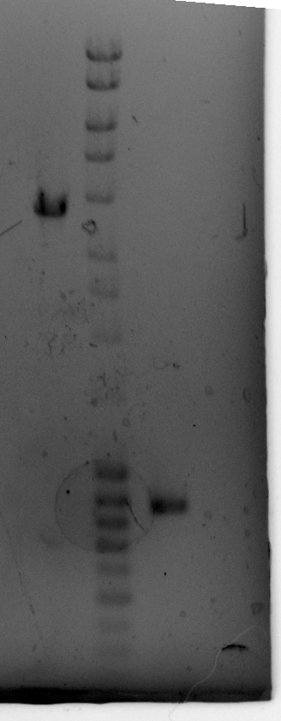
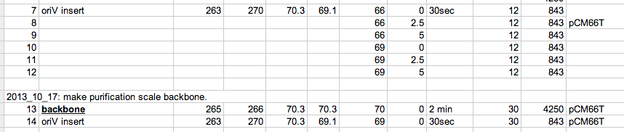

Slide 4
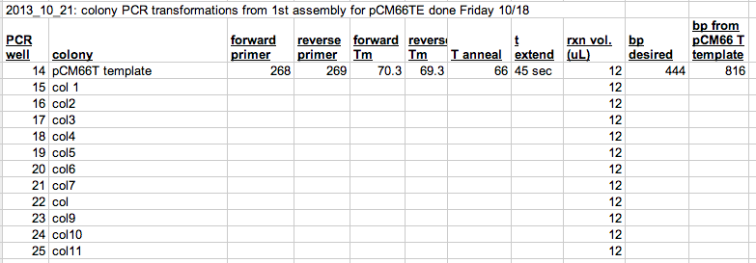
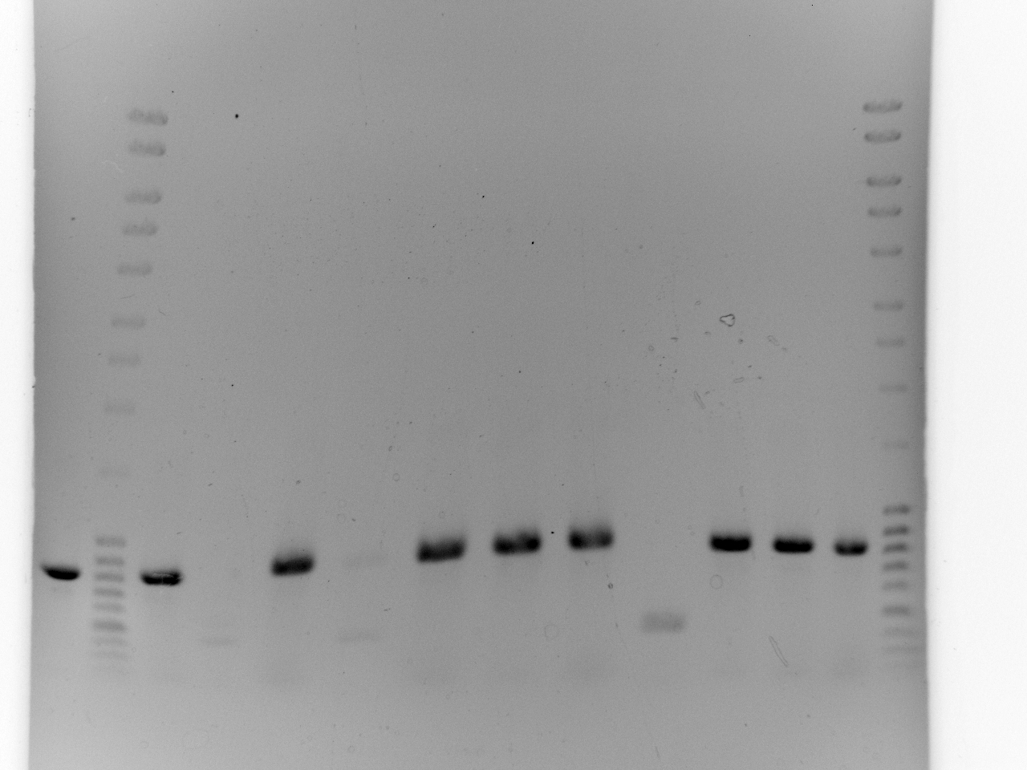
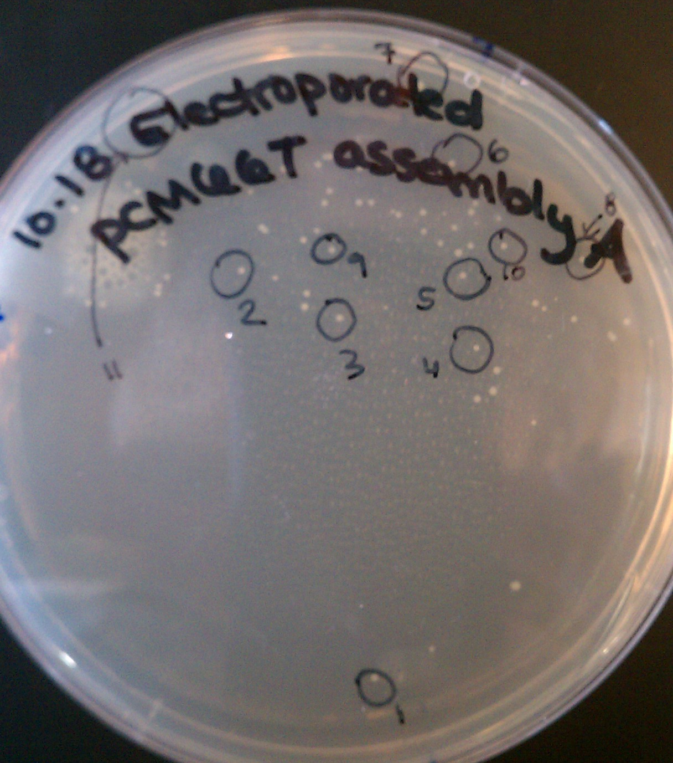
Restreak #2, #4, #8.
?? Is Oriv affecting copy number in E. coli??

Slide 5
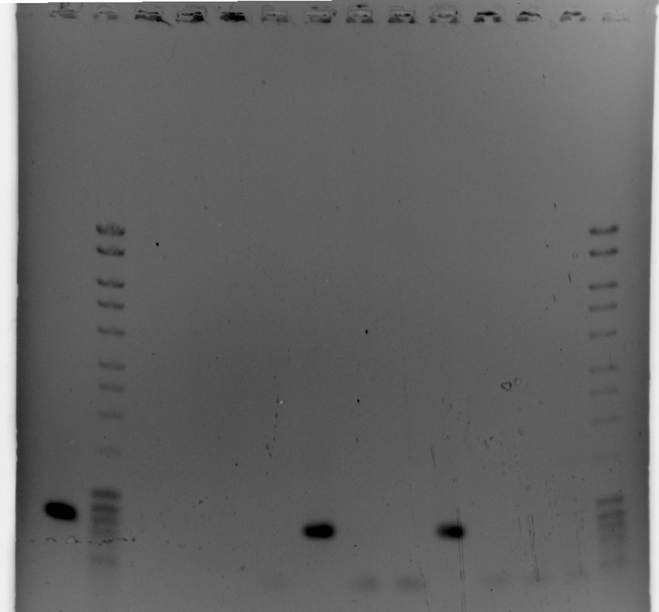
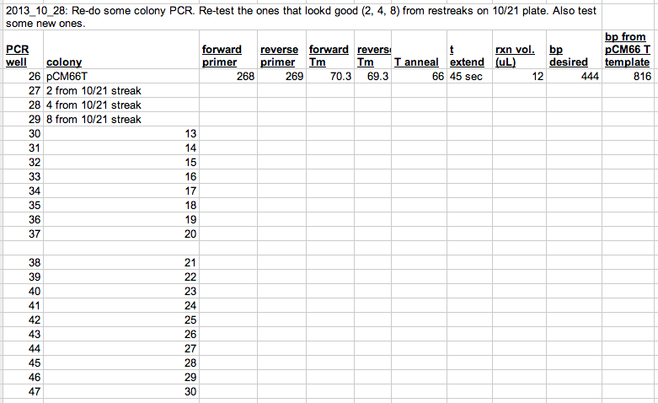
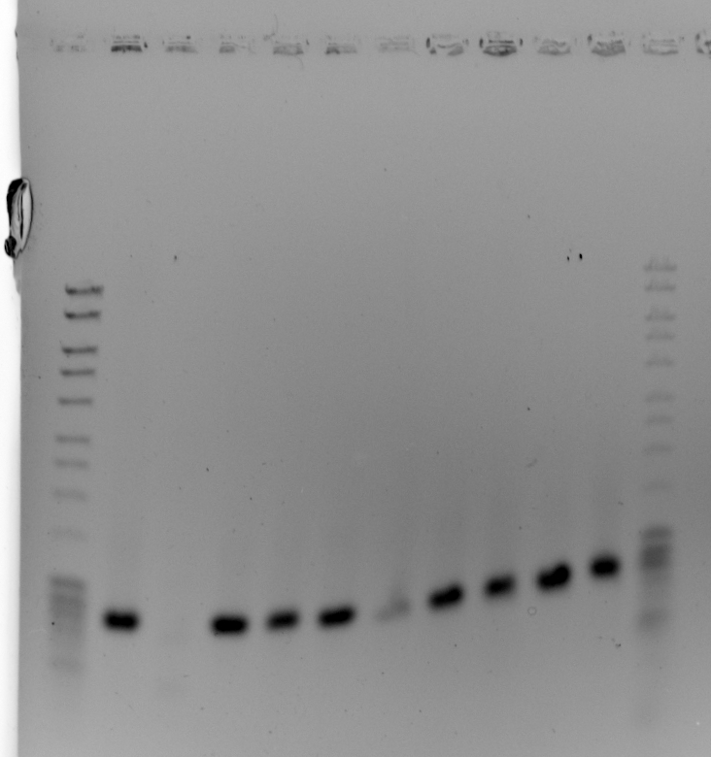
sequenced colonies 2 and 4 in order # 10-242202803
I accidentally sequenced using the name p15A pTrc RFP pCM66T
primer 42 matches pCM66T (template). Need to screen more colonies. The + bands for colonies 2, 4, 8 looked rather faint now that I see.
I need a test that tests + if plasmisd

Slide 6
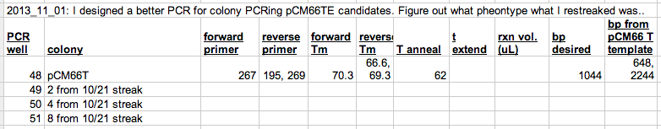
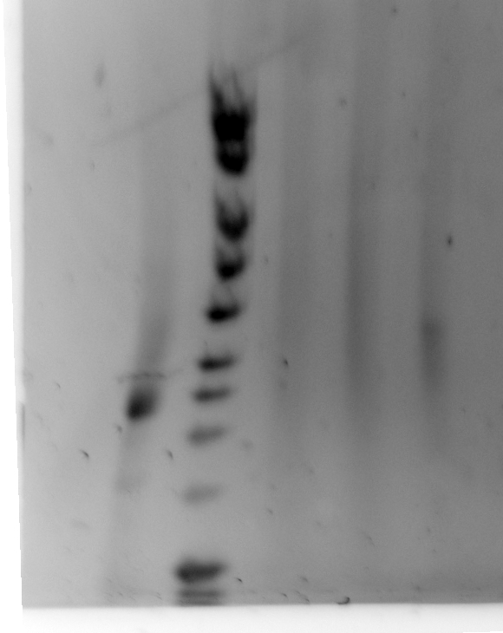
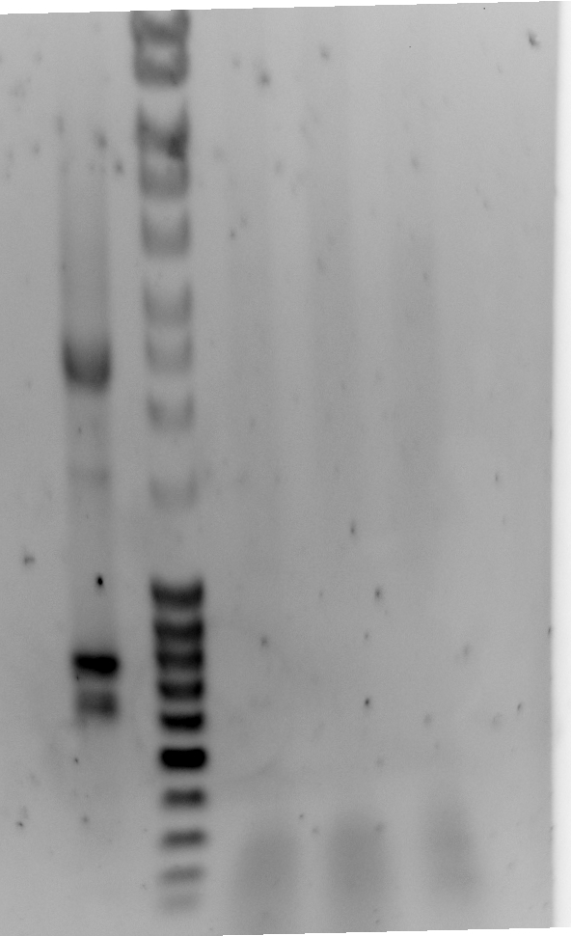
140V is too high?? For ~30 min in left box with new buffer.
Re-run what’s left at 120V. Well 51 only had 2uL, but the others had about enough for 4 uL rxns.
These don’t look good, so colony PCR the new transformants from yesterday. Hope to find a good one.

Slide 7
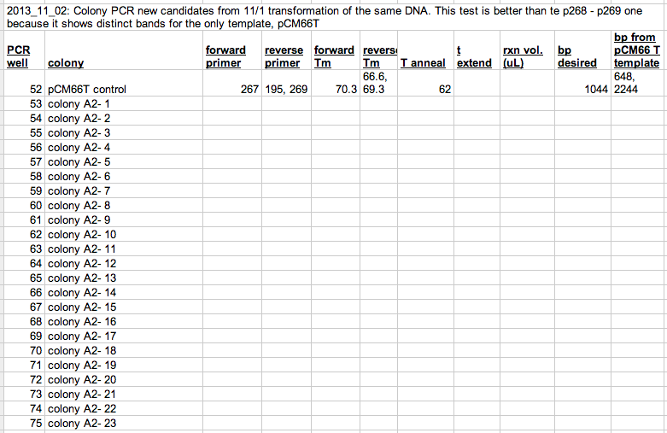
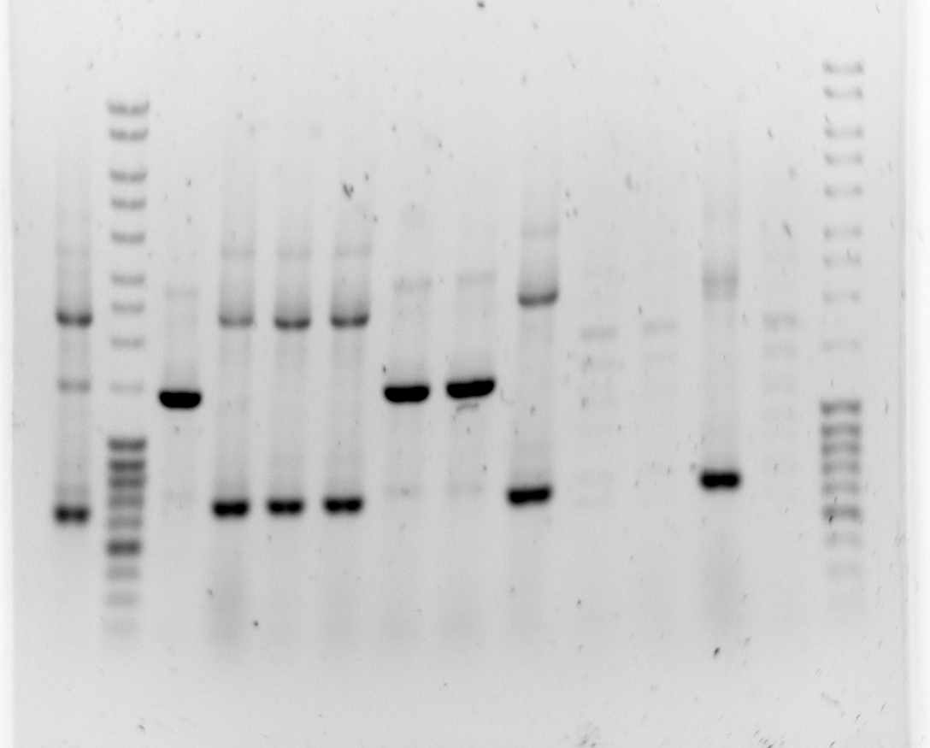
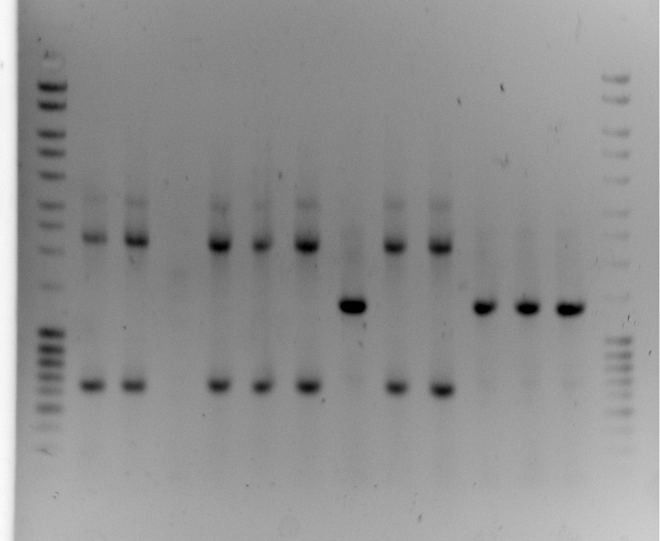
Colony A2-11
Colony A2-16
Colony A2-15
Colony A2-20?
Colony A2-4
Colony A2-10
Colony A2-12
Colony A2-22?
Colony A2-21?
Colony A2-3
Colony A2-13
Colony A2-18?
Colony A2-23?
Colony A2-2
Colony A2-7
Colony A2-19?
Colony A2-17
Restreak #s 2, 3, 4, 7, 10, 11 fairly big.
Restreak #s 12, 14, 15, 16, 12, 20 smaller on another plate.
Miniprep col 2 & col 4
Sequence with primer 268 and 212. 212 will clarify whether this is pCM66TE or pTrc RFP pCM66TE
131106:
Oops… I restreaked and sequenced the ones that were pCM66T, not pCM66T. Keep the *other* colonies.
Keep A2-1, A2-5, A2-6, A2-17, A2-18, A2-21, A2-22
Restreak from fridge plates 131106
Use 11/1 plate from 2nd transformation of assembly A (this is why the colonies are A2-#

Slide 8
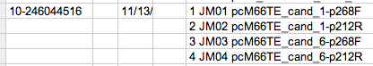
2013_11_18: I looked at sequencing from 10-246044516.
They were all pC66T, not pCM66TE.
Did I send in the wrong colonies?
My annotation of the colonies based on the PCR wasn’t perfect.
I restreaked # 18, but I probably wanted # 19. Restreak A2-19 today and PCR test later.
Did I misinterpret the colony PCR?
No..
Set up same PCR to figure out whether the colonies somehow got switched. Test lawn area of 11/6 restreak of 11/1 transform/

Slide 9
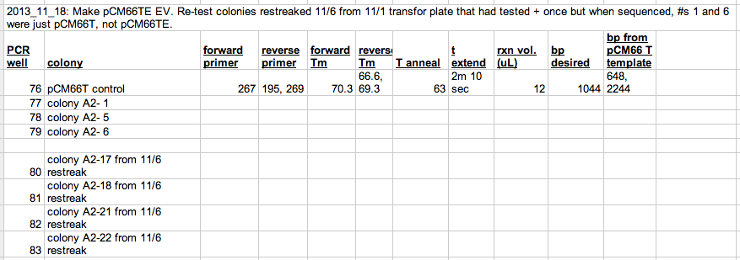
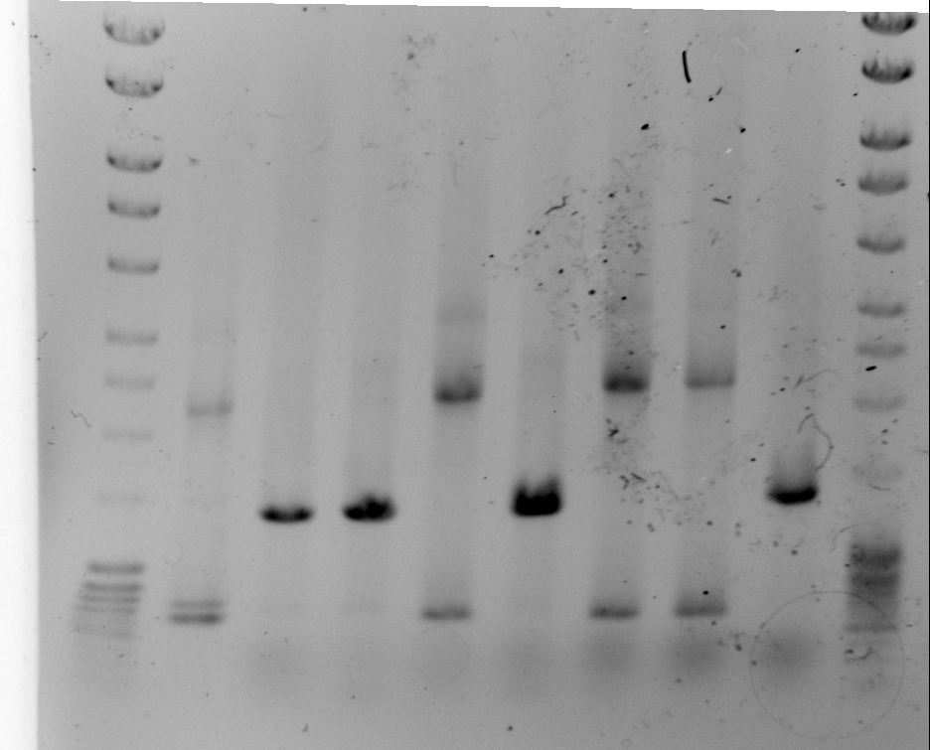
A colony that is correct is supposed to have 1044 bp. Is this incorrect? These colonies, including A2-1 and A2-6 have more like 1300 bp.
This is also true of the colonies screened 11/2, 2 slides ago with orange writing.
I re-calculated the distances below. Also, check that the sketch of the completed construct is correct.
A2-6 (pCM66T)
A2-21 (pCM66T)
pCM66T control
A2-5
A2-17
A2-22
A2-1
A2-18 (pCM66T)
*
Primers: |  | BP in templates and construct
F | R | Desired bp | pCM66T template
267 (before OriV) | 269 (Inside ColE1) | 995 | 2225
267 (before OriV) | 195 (inside IncP origin of transfer, TraJ’ {what I cut}) | none | 648

Slide 10
2013_11_18: I think my sketch of the final construct is wrong. Re-built the component pieces and the expected assembly from these. Re-do the PCR table.
Primers: |  | BP in templates and construct
F | R | Desired bp | pCM66T template
267 (before OriV) | 269 (Inside ColE1) | 995 | 2225
267 (before OriV) | 195 (inside IncP origin of transfer, TraJ’ {what I cut}) | none | 648
There aren’t similar matches for p195 or p269 in the new design goal. Not 267, either.
How am I getting a ~1.4 kb band???
My best guess so far is that the products used to assemble are somehow wrong.

Slide 11
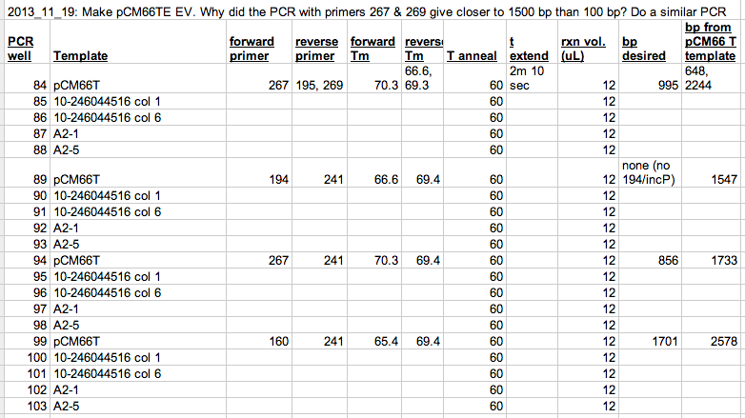
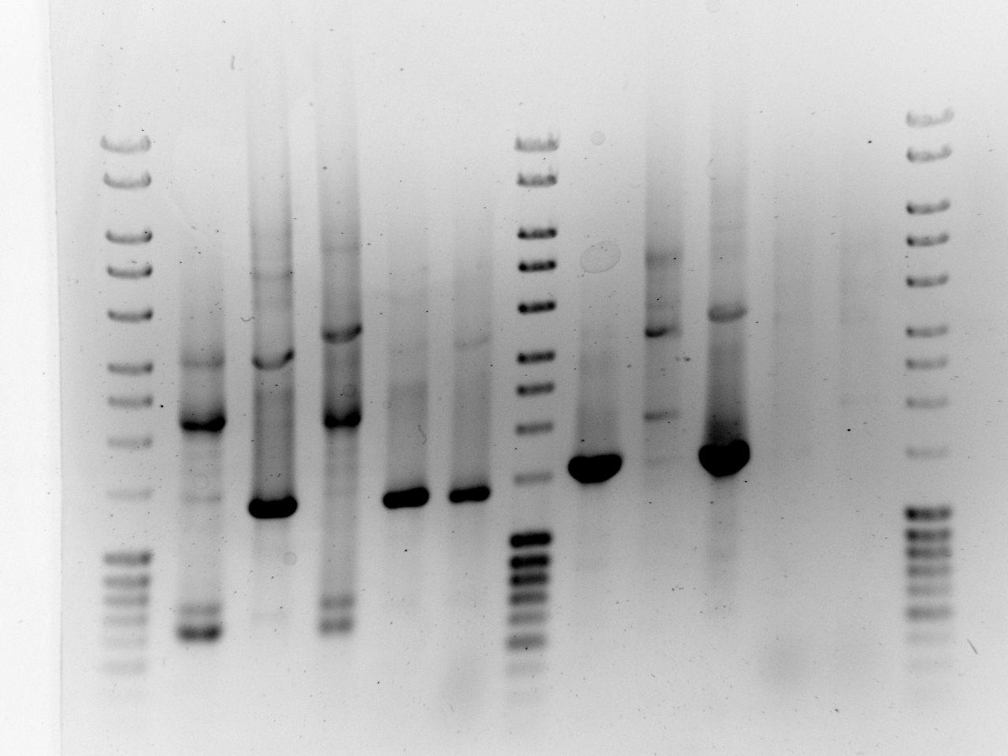
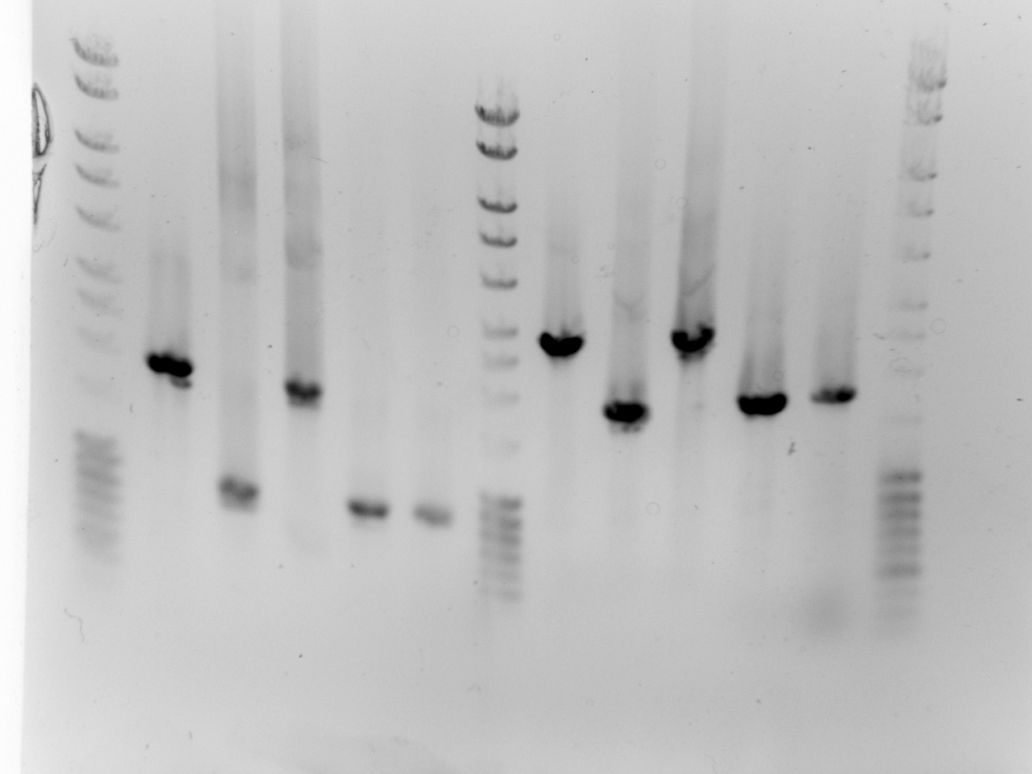
2013/11/19: follow up on confusion about sequencing in:
p241 is the priming region for the reverse primer in the OriV insert.
Primer 269 is past that, in ColE1.
Difference between 269 and 241 as reverse primers is that 269 tests bot seams, whereas 267 only tests one.
Is it possible that only the upstream seam is correct?
says IncP origin of transfer is gone as desired.
Upstream seam should be correct, but downstream seam broken. Trimmed part should be missing only in colony 1 sequenced in 10-…44516
p160 is redundant with p 267; doesn’t test anything new about seams
Wells 84-88
p267 -> 159 or 269
(test both seams)
Wells 89-93
p194 -> p 241
(+ if trimmed part is present)
Wells 94-98
p267 -> p241
(test 1st seam)
Wells 99-10
p160 -> p241
(test 1st seam)
pCM66T control
*
*
x
*
*
*
*
x
*
*
*
*
*
pCM66T control
pCM66T control
pCM66T control
194 amplifies if piece I cut is present
*

Slide 12
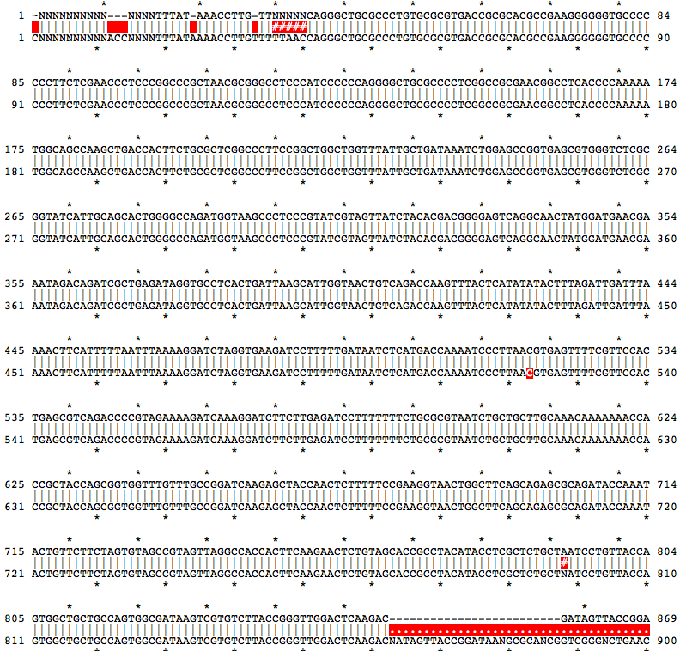
2013/11/20: Review sequencing
10-244552813 10/28: colony 4
seq w/ p269. Poor quality. Free repeat → no priming.
10-245333907 11/5: colonies B2, B4
both were pCM66T, not pCM66TE. I had misinterpreted the colony PCR and chosen the wrong colonies. Not sure why I named them B#, because they were lableled A2-2 and A2-4 in slide 7
10-246044516 11/13(ish): new colonies 1 & 6
1, 5, 6 all looked good. I inoculated from 1 and 6 restreaks
These also appeared as pCM66T, not pCM66TE. Analyze colony PCR done yesterday to clarify:
267 -> 269 should be 995 bp but colony 1 was ~1500 bp and colony 2 was ~2244. I’m surprised they sequenced the same then. The sequencing reads also align the same, exactly matching pCM66 not pCM66TE.

Slide 13
.
.
194 -> 241 should only amplify if the cut bit is present because 194 is inside the IncP origin of transfer part cut.
It is even more convincing now that colonies 1 & 6 should have sequenced differently.
Sequence with primer 267 to see if OriT is gone as desired. PCR suggests it should be!
just discovered primer 266 has Tm = 65oC
backbone was made with Tm = 67 or 70oC (unclear).
There was trimming on both sides of the IncP origin of transfer
Did I only achieve trimming on one side?
PRIMERS 256 and 270 HAVE SIGNIFICANT HOMOLOGY
Alignment:
Alignment statistics for match #1
Score Expect Identities Gaps Strand
50.1 bits(25) 9e-13 25/25(100%) 0/25(0%) Plus/Minus
Query 1 GCCGGATCAAGAGCTACCAACTCTT 25
|||||||||||||||||||||||||
Sbjct 39 GCCGGATCAAGAGCTACCAACTCTT 15
was the backbone really one piece that self-assembled?
can I just screen more colonies to look for ones that are correct?

Slide 14
Figure out 1-piece assembly.
Backbone was built with:
265 gccggatcaagagctaccaactctt
266 cccagcggcgagggcaaccagcccggtgagcgtcggaaagggtcaagggcacattgcccc
Seuqencing () revealed:
first seam is perfect.
Sequences correctly through GGGTCTCGCGGTATCATTG, the intended priming region for the reverse primer. I’m not sure where it goes after that.
What priming went wrong?
Shouldn’t be primer 270 mispriming because then the insert would go from ~840 bp to ~1240 bp and the gel doesn’t show that. It is def ~840.
That leaves the forward primer on the backbone. No significant homology for other places on pCM66T though.
OR, I could have used the wrong forward primer and the correct reverse primer on the backbone. This product retains the IncP origin of transfer, so it isn’t right.
263 OriV-F cctttccgacgctcaccg
266 Gibson_trim_before_oriV-R cccagcggcgagggcaaccagcccggtgagcgtcggaaagggtcaagggcacattgcccc
This explains the constructs perfectly!
This pair also works, but cuts out the desired piece.
265 ColE1-F gccggatcaagagctaccaactctt
270 replace_p_264 gttaccttcggaaaaagagttggtagctcttgatccggcgcaatgataccgcgagaccc
To fix, re-do backbone with correct primer pair. Or, treat these with the opposite mismatched pair of primers and just fix the other seam.

Slide 15
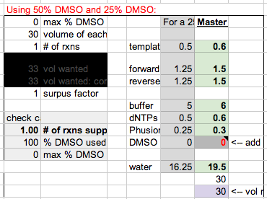
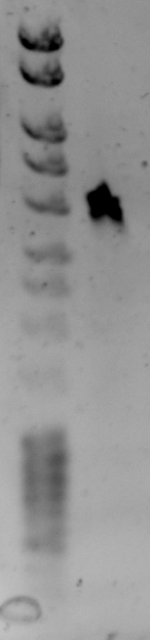
Looked good. Add ½ uL Dpn1 from 3:30 -

Slide 16
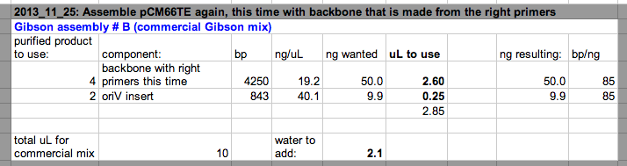
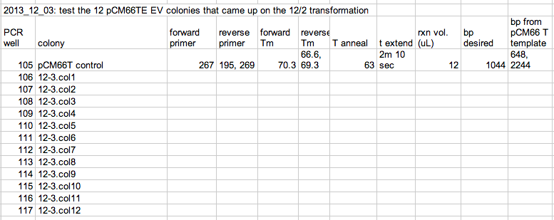
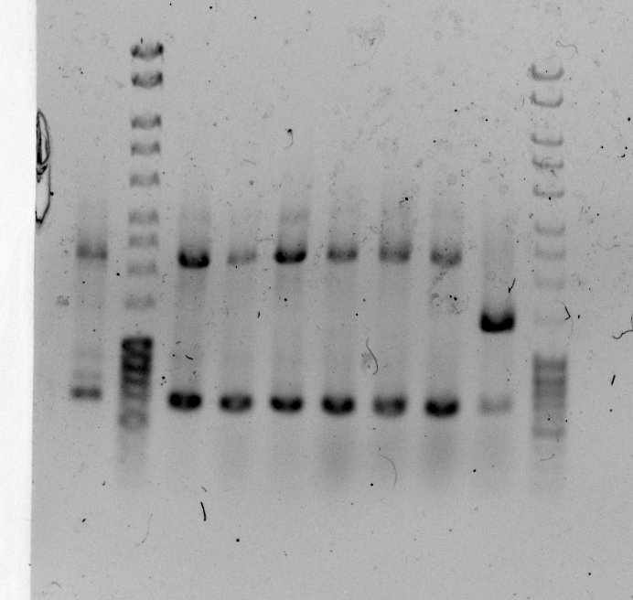
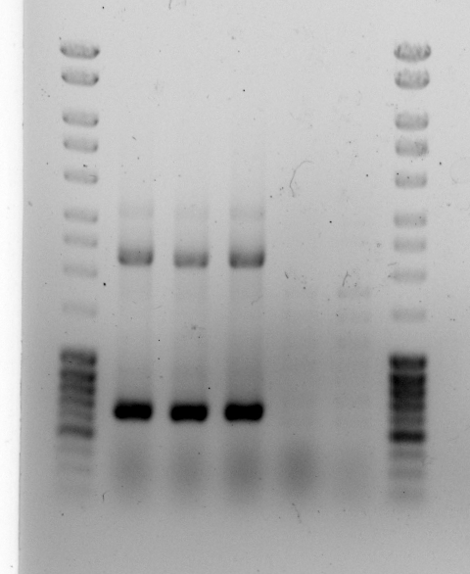
Only colony 7 looks good. Restreak it.
Electroporate 4 more uL of the same assembly mix as a backup.

Slide 17
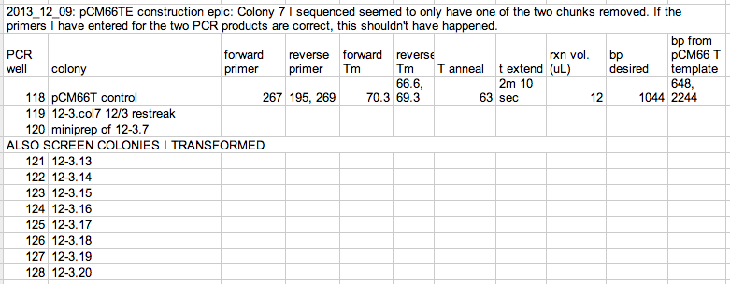
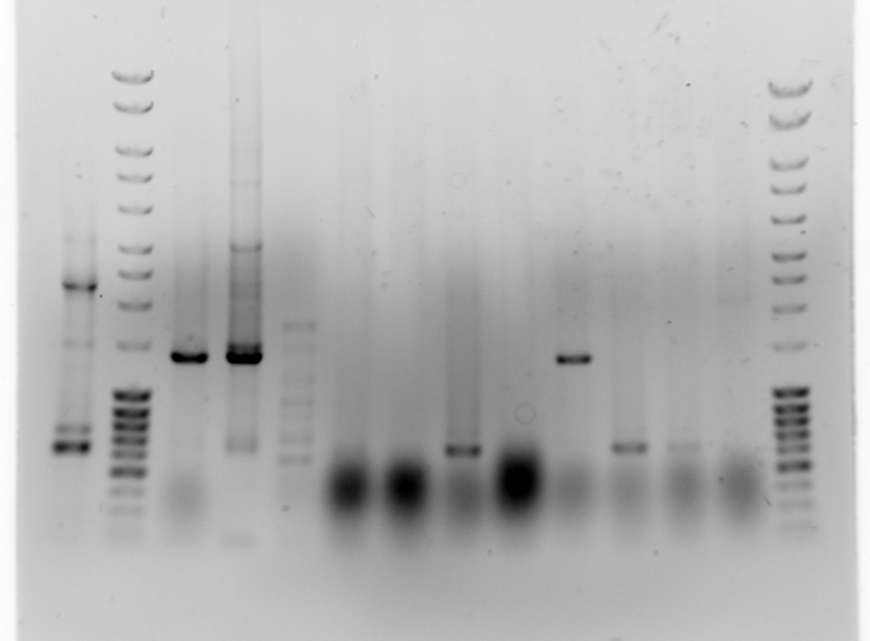
2013/12/03: Electroporate more of assembly B in case colony 7 doesn’t work out.
pCM66T control
12-3.7 restreak
12-3.7 miniprep
12-3.18
12-3.21
Colony PCR says 12-3.7 should be ok. Why did it have the downstream part?
Restreak 12-3.18 as a backup.
This is closer to 1500 bp than 1000.

Slide 18
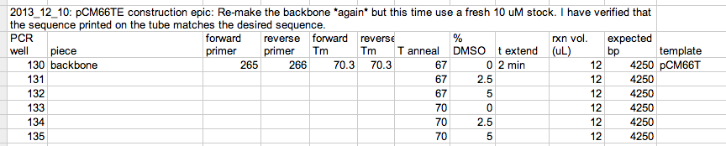

I can’t figure out what went wrong, but 12-3.7 is missing OriV; it just didn’t trim out the useless bp after.
Unfortunately I can’t keep it because of an insertion.

Slide 19
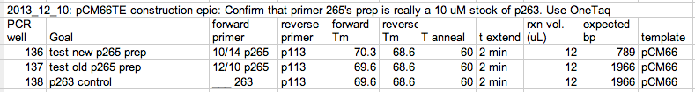

Slide 20
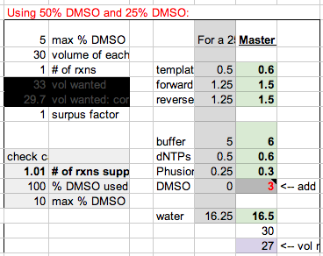
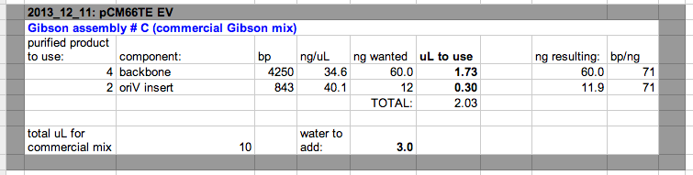

Slide 21
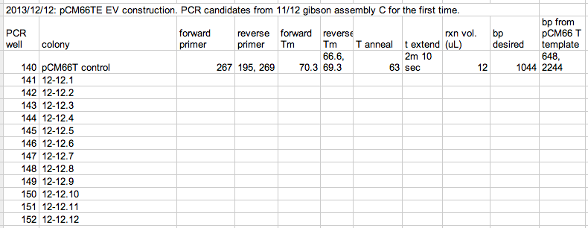
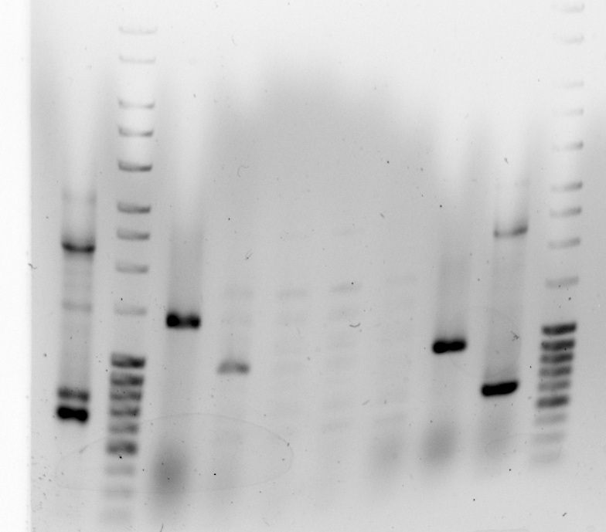
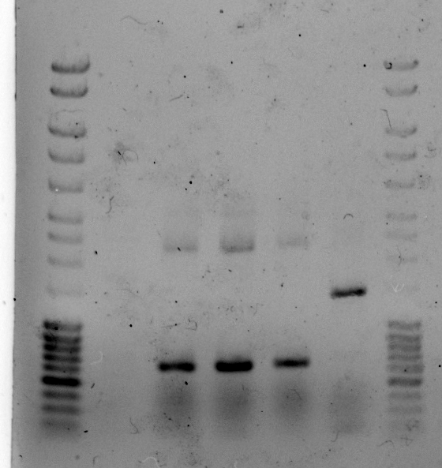
Restreak 12-12.2 and 12-2.6
Hmm… wanted 1044 bp; this is a little smaller b/c that band is 1031
12-12.2
12-12.6
1031 bp
1031 bp

